Slide 1
The E-Vulnerability Index Service Research Division Service Policy and Strategy Directorate Employment and Social Development Canada (ESDC)

Slide 2
Table Of Contents
Background
Creation of the Index of E-Vulnerability (EVI)
- Challenges and Data sources
- Methodology
- How to read the index?
Analytical Results
- EVI scores at the national level
- EVI scores by different segments of the population across Canada
- EVI by Service Canada Center
Does the E-vulnerability Index vary by Service Canada Center?
Service Canada Center – Examples

Slide 3
Background
With the increase in Internet-related technologies and Internet use, the Government of Canada is offering more and more services online.
This shift is reinforced by the 2014 Treasury Board of Canada Policy on Service which establishes the principle that Government of Canada’s services should be designed and delivered by considering client needs and feedback, and should be progressively e-enabled, not only to provide a better client service experience but also for efficiency purposes.
Accordingly, many services (e.g. the Employment Insurance application process) are now being provided online by Service Canada and a great number of Canadians are benefiting from the resulting efficiency.

Slide 4
Background (cont’d)
However, some segments of the population are likely to experience financial, attitudinal and/or skill-based barriers when using government’s online services.
These so-called “e-vulnerable” individuals will need different kinds of support to answer their needs.
In light of this, Service Canada remains committed to providing an in-person option for service delivery throughout Canada (known as the in-person point-of-service “footprint”).
Totally, more than 500 Service Canada Centres (SCCs) across Canada provide a wide range of government programs and services to Canadians, including Employment Insurance, Canada Pension Plan, Old Age Security, Passport, etc..
It is important, therefore, that Service Canada has access to measures of e-vulnerability to inform its Service Delivery and Service Transformation Strategies.

Slide 5
Background (cont’d)
SOLUTION: To answer the need of information on e-vulnerable population segments, Service Research Division within ESDC has developed an index of e-vulnerability (EVI) for each of the Service Canada Center (SCC).
DEFINITION: The EVI measures the extent to which some individuals will be at a service disadvantage with the digitization of services. The index measures three dimensions of cyber vulnerability:
Internet Access: The access dimension measures whether or not individuals have the means (financial, material) to benefit from available technologies.
Comfortability: The comfortability dimension relates to the willingness or desire
of individuals to use technologies.
Competencies: The skills/competencies dimension captures whether or not individuals have the necessary abilities and knowledge to take advantage of the technologies.
ADVANTAGE: This information will enable the Government of Canada to identify Service Canada Centres that are servicing more e-vulnerable Canadians.

Slide 6
Background (cont’d)
This measure of e-vulnerability refers to the concept of “digital divide”.
The concept of digital divide has been conceived by Husing and Selhofer (2002) as the “gap between citizens from different socio-economic backgrounds with regard to their opportunities and abilities to access and use information and communication technologies …”.
There has been significant research dedicated to understanding the digital divide and identifying ways to effectively measure it (Barzillai-Nahon, 2006).

Slide 7
Creation Of The Index Of E-Vulnerability
Challenges and Data sources
Data pertaining to the Internet readiness of the overall Canadian population is primarily collected through the following surveys:
Canadian Internet Use Survey
Last conducted in 2012 by Statistics Canada, new data in 2018;
Observations collected from 22,615 individuals aged 16 and older;
The CIUS includes a set of questions identifying increasingly advanced tasks that individuals can perform using the Internet, from sending and receiving email to selling goods and services online;
Questions in the CIUS are related to “Internet Access” and “Comfortability”.
Programme for the International Assessment of Adult Competencies
Last conducted in 2012 by Statistics Canada;
Observations collected from 25,267 individuals aged 16 to 65;
The PIAAC assesses not only respondent’s computer literacy, but also the ability to solve problems in a technology-rich environment (PS-TRE);
Questions in the PIAAC are related to Internet “Competencies”.
CIUS
PIAAC

Slide 8
Creation Of The Index Of E-Vulnerability
Challenges and Data sources
Neither of those two surveys has enough sample size to generate reliable information at the Service Canada Centre level.
To address this issue, our solution was to recreate those three dimensions of e-vulnerability (Access, Comfort and Competencies) for each respondent in the National Household Survey (NHS).
The 2011 NHS covered 4.5 million dwellings and 6.7 million Canadians. Though the NHS collects a wide array of demographic and socio- economic information, it does not include any questions relating to Internet use or skills.
NHS

Slide 9
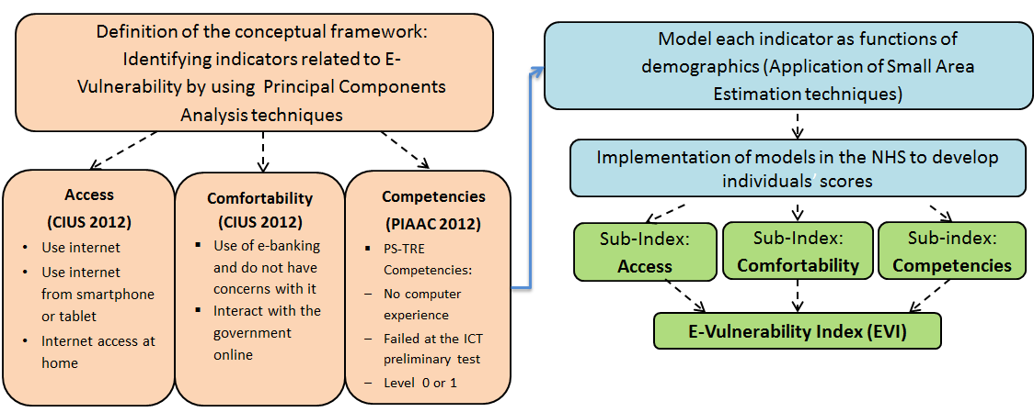
Creation Of The Index Of E-Vulnerability
Methodology
*
*PS-TRE: problem solving in technology-rich environments
EVI and sub-index were created using factor analysis
Each sub-index is a weighted score of a number of indicators
The EVI is a weighted score of the sub-indices
Models account for observed regional variations (Small Area estimation techniques)
Notes:
PS-TRE : problem solving in technology-rich environments

Slide 10
Creation Of The Index of E-Vulnerability
How to read the index?
Results: Each individual in the NHS (16 and +) was assigned a specific EVI score ranging between 0 and 1
0: Individual is at very low risk of being e‑vulnerable
1: Individual is at very high risk of being e‑vulnerable
An e‑vulnerability score is first determined at the individual level and since the NHS contains the postal code of the each respondent, the index can be aggregated to the geographic level of our choice (census metropolitan area (CMA), census subdivision (CSD), Service Canada Centers point of services)

Slide 11
Analytical Results
EVI scores at the national level
The average individual EVI score nationwide is 0.38.
The average individual scores for the:
Access dimension is 0.29
Comfort dimension is 0.41
Skills dimension is 0.61
EVI Scores for the Top CMAs
Top CMA | Population Living in the CMA | EVI Score | Access Sub-Index Score | Comfort Sub-Index Score | Competencies Sub-Index Score
Toronto | 4,473,165 | 0.35 | 0.25 | 0.37 | 0.60
Montréal | 3,072,610 | 0.38 | 0.30 | 0.40 | 0.63
Vancouver | 1,897,675 | 0.34 | 0.24 | 0.38 | 0.58
Ottawa-Gatineau | 989,105 | 0.32 | 0.24 | 0.35 | 0.52
Calgary | 961,120 | 0.29 | 0.19 | 0.33 | 0.50
Edmonton | 921,090 | 0.33 | 0.24 | 0.36 | 0.59
Québec | 626,010 | 0.38 | 0.31 | 0.39 | 0.62

Slide 12
Analytical Results
EVI scores by different segments of the population across Canada
A national E-Vulnerability Index (EVI) could help service delivery organizations support the shift to digital services by helping to mitigate unintended consequences on e-vulnerable groups.
The index was customized for the different subgroups:
Immigrants
Youth
Seniors

Slide 13
Analytical Results
EVI by Service Canada Centre
The EVI is also useful for comparing the extent to which the population serviced by each Service Canada Center is likely to be at a disadvantage with respect to online service delivery.
Service Canada maintains an administrative database of the location of in-person points-of-service across Canada. This database includes postal codes located within 50km driving distance of each point-of-service.
We estimated the average EVI of the population serviced by a Service Canada Centre, by linking the 2011 NHS information to the Service Canada administrative database using postal codes.
Advantages:
Knowing the EVI of the population residing within 50 km of each SCC;
Providing information to local service centres about the demographic of their clientele (residing within 50 km radius);
Providing the evidence-based indicator for modernizing services for clients.

Slide 14
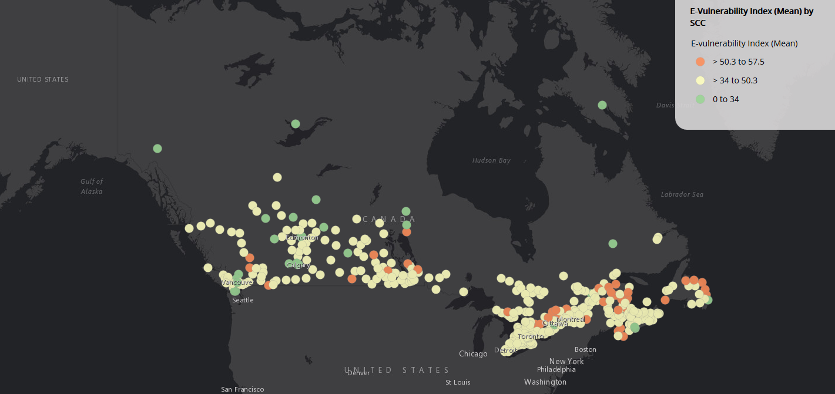
Analytical Results
Does the E-vulnerability Index vary by Service Canada Center?
High e-vulnerability Moderate e-vulnerability Low e-vulnerability

Slide 15
Analytical Results
Service Canada Center – Examples
Service Canada Centre: Shoal Lake (MB) |  |  | Certain socio-demographics characteristics of the population living within 50 km radius of Shoal Lake Center High proportions of seniors in area (23.2%) High low-income rate (28.8%) Highly rural population (99.8%) No High School Diploma (32.8%) Recent Immigrant (1.9%)
Population within 50km |  | 8600
Average EVI score of population |  | 0.52
Population with high vulnerability |  | 1505
Service Canada Centre: Winnipeg La Verendrye (MB) |  |  | Certain socio-demographics characteristics of the population living within 50 km radius of Winnipeg La Verendrye Low proportions of seniors in area (13.1%) Lower low-income rate (15.6%) Mostly urban population (90.6%) No High School Diploma (20%) Recent Immigrant (8.5%)
Population within 50km |  | 754980
Average EVI score of population |  | 0.37
Population with high vulnerability |  | 54740

Slide 16
Conclusion
The e-vulnerability index (EVI) indicates Service Canada’s clients who could be at a service disadvantage with the move to digital services.
The average individual EVI score nationwide is 0.38.
Some segments of the population are more susceptible to face challenges when using online services (including immigrants and indigenous population).
EVI can be customized for different geographical areas and subgroups of the population.
It provides additional information to local SCCs about the demographic characteristics of their clientele.
It supports informed design and delivery of service programs, particularly those that target specific segments of the Canadian population.
Upcoming update of the index using the new Census data (2016) and CIUS (2018).

